Slide 1

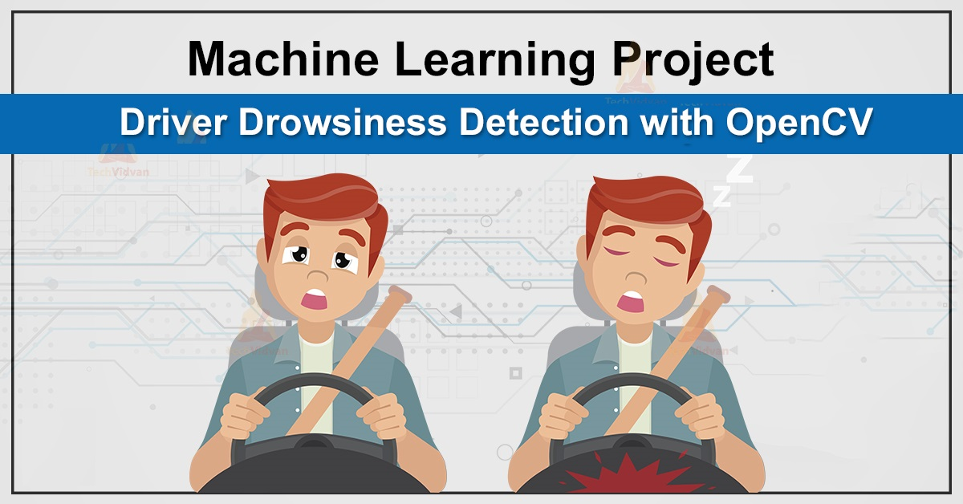
Oriental Institute of Science and Technology, Bhopal Department of Computer Science and Engineering Progress Seminar - I on DRIVER ALERT [ Driver Drowsiness Detection System ] (Minor Project) Session 2021-2022 Presented by: 1. Anshul Verma (0105CS191023) [Team Leader] 2. Harshit Shrivastava (0105CS191048) 3. Manish Nathrani (0105CS191062)
Guided By : Prof. Goldi Jarbais

Slide 2
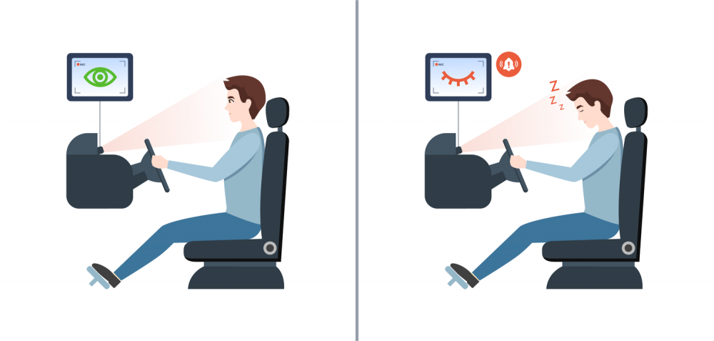
Introduction
Nowadays Driver Drowsiness is a major factor in a large number of vehicle accidents.
Recent statistics estimate that annually 1,200 deaths and 76,000 injuries can be attributed to fatigue related crashes.
The development of technologies for detecting and avoiding drowsiness at the wheel is a major challenge in the field of accident avoidance systems.

Slide 3
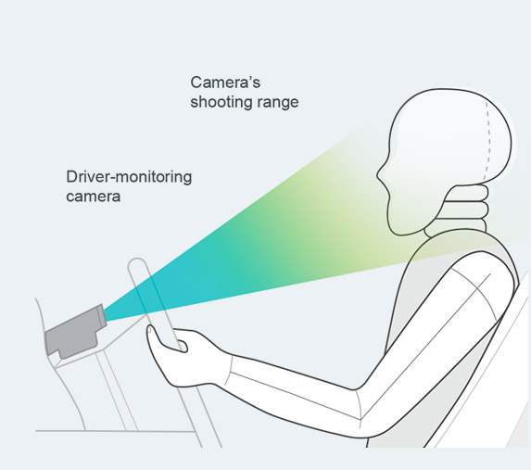
Detail Idea of Project
The aim of this project is to develop a Driver Drowsiness Detection System.
The focus is on designing a system that will accurately monitor the open or closed state of the drivers eyes in real-time.
It is also found that the symptoms of driver fatigue can be detected early enough to avoid a car accident.
Detection of drowsy involves a pattern of images of a face, and the observation of eye movements and blink rate.

Slide 4
how it works…
Step 1 – Take image as input from a camera.
Step 2 – Detect the face in the image and create a Region of Interest (ROI).
Step 3 – Detect the eyes from ROI and feed it to the classifier.
Step 4 – Classifier will categorize whether eyes are open or closed.
Step 5 – Calculate score to check whether the person is drowsy.

Slide 5
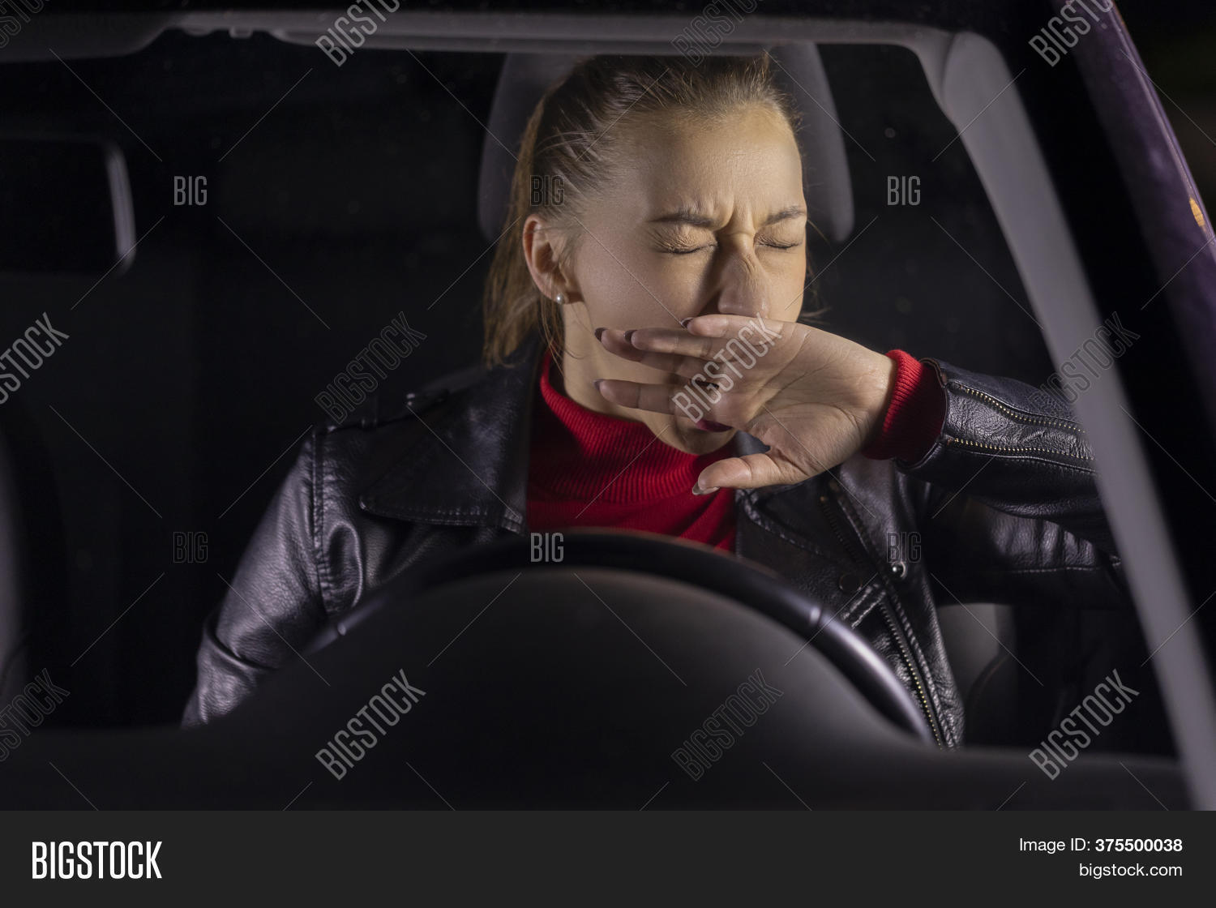
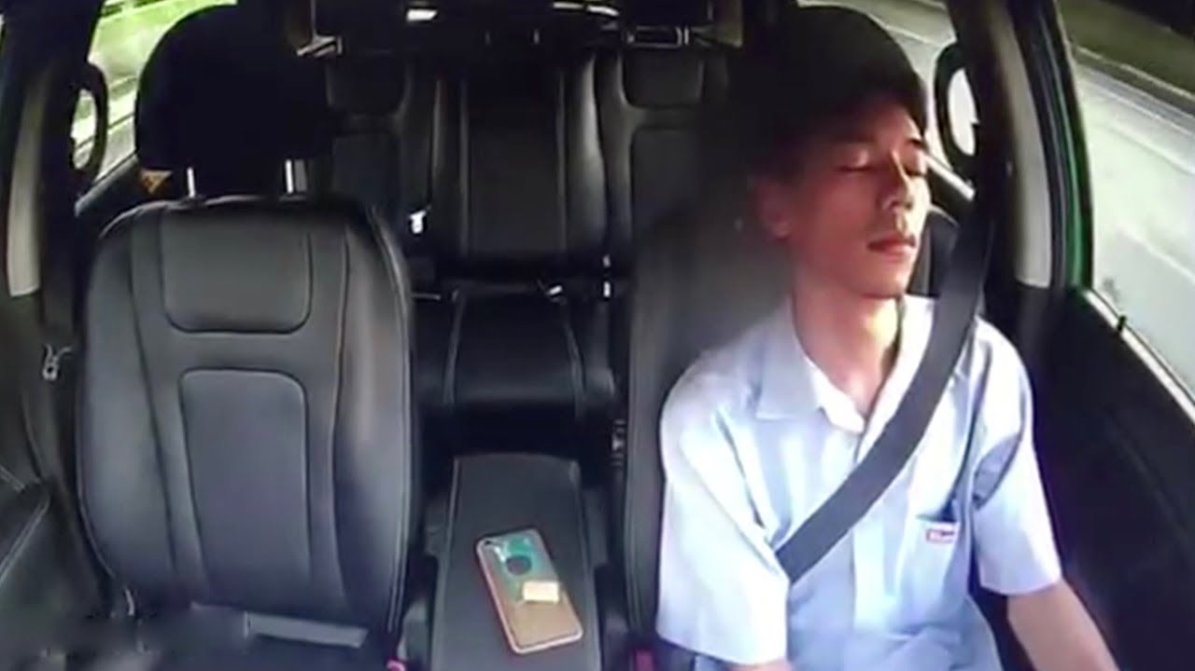
TIME FOR WAKING UP THE DRIVER TO AVOID ACCIDENTS :-
CARELESS DRIVERS

Slide 6

Alarming Sound

Slide 7
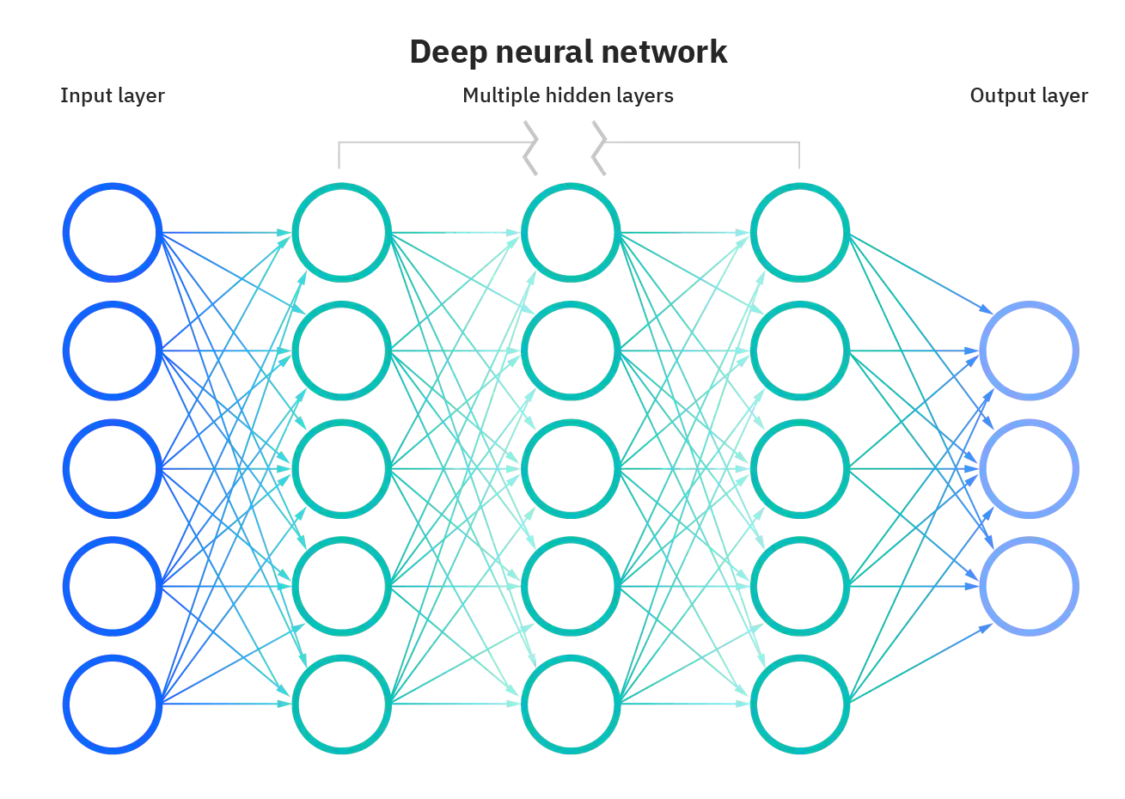
PRE-REQUISITE
Use of Python
Machine Learning
Deep Learning Models
Neural Network
( specifically Convolutional Neural Network {CNN} )
Dataset from Kaggle

Slide 8

Technologies
The necessary Python Libraries which will be required are : -
OpenCV – face and eye detection
TensorFlow – keras uses TensorFlow as backend
Keras – to build our classification model
Pygame – to play alarm sound
Numpy – for mathematical operations
The requirement for this Python project is a Webcam through which we will Capture Images and a Speaker to play the Alarming Sound.

Slide 9



Timeline of the project
Deep Learning
Convolutional Neural Network (CNN)
Artificial Intelligence
Research
Testing
We are Here...
Training of Model and improving Accuracy
Research
24th – 31th October 2021
8 Days
Research
11th – 16th October 2021
6th – 13th November 2021
Just in Few Days
6 Days
8 Days
02
Start
9th October 2021
01
03
7 Days
Machine Learning
Neural Network
Development
Completion
Research
Research
Implementation
Deadline
17th – 23th October 2021
1st – 6th November 2021
6 Days
Currently working on it...
30th November 2021

Slide 10
methodology
We found out Two Approaches to make this Project -
Approach A :
Using 68 Facial Landmarks
Approach B :
Using the Concept of Model Training and CNN

Slide 11
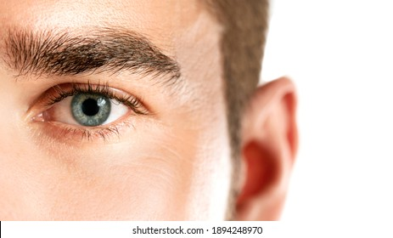
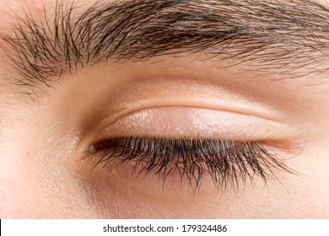
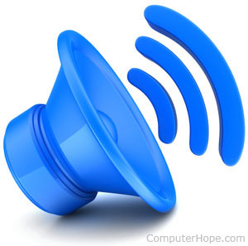
APPROACH A
COMPARING DISTANCES

Slide 12
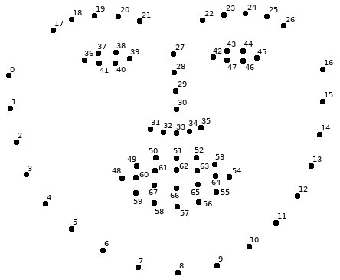
Below you can see a representation of the numbered facial landmarks
Facial Landmarks

Slide 13
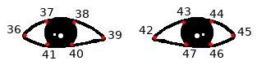
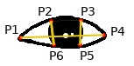
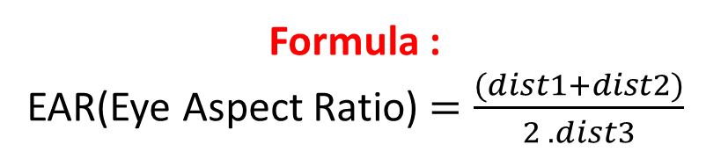
Eye Detection
Eye Landmarks
Vertical and Horizontal distances
Vertical Distance
dist1 = P2 − P6
dist2 = P3 − P5
Horizontal Distance
dist3 = P1 − P4
Formula :
EAR(Eye Aspect Ratio) $=\frac{(dist1+dist2)}{2 . dist3}$

Slide 14
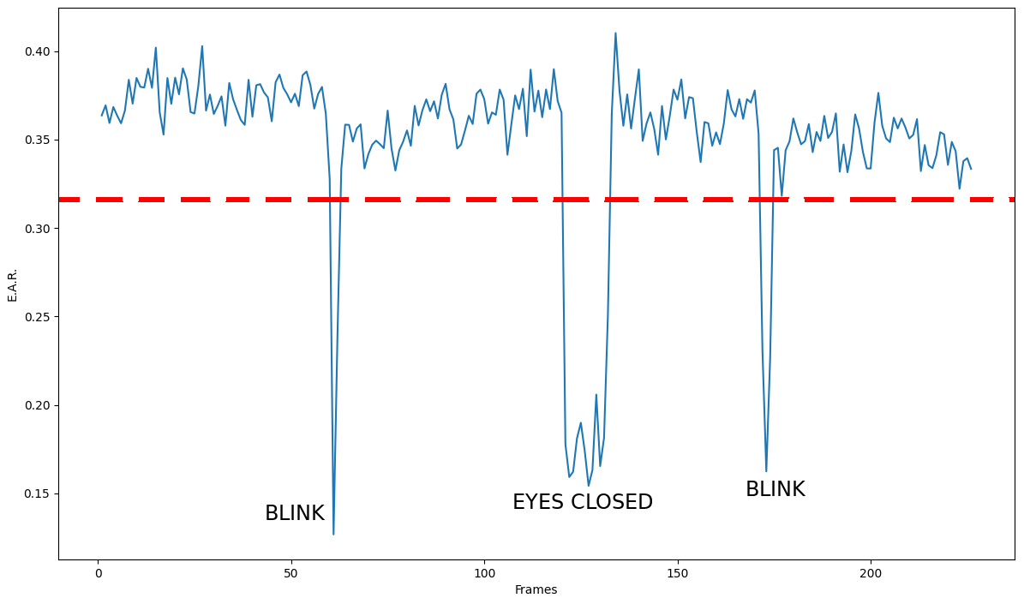
Blinks and eyes closed intervals

Slide 15
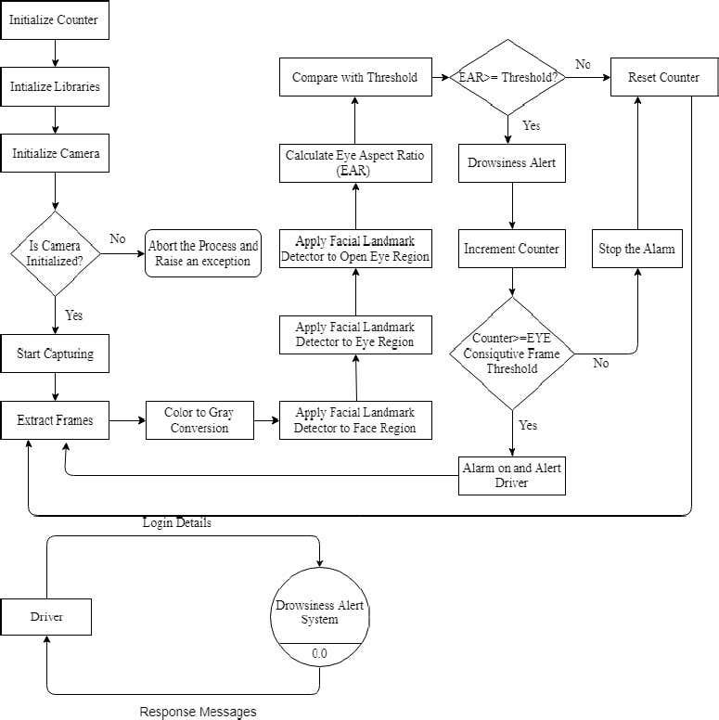
FLOWCHART

Slide 16

APPROACH B

Slide 17
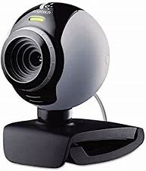
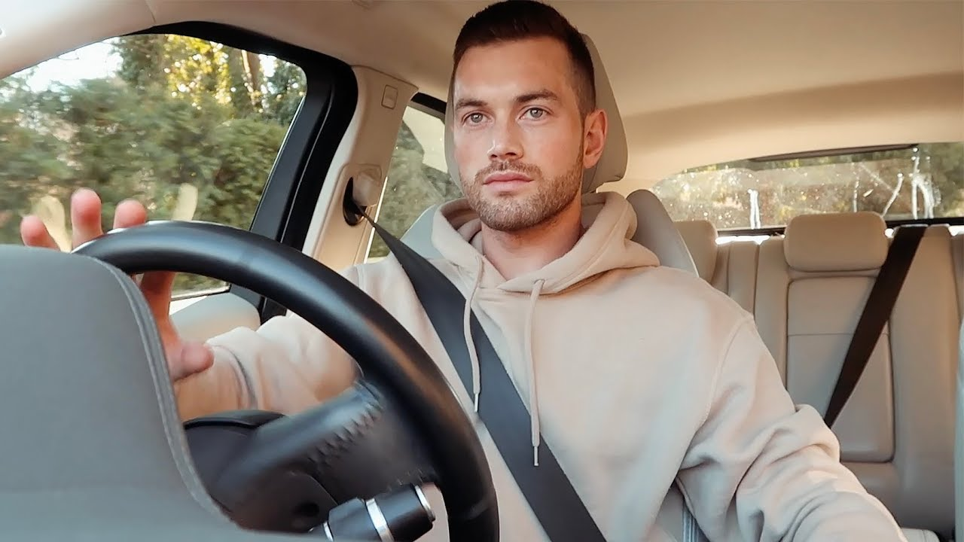
Step 1 – Take Image as Input from a Camera
Camera
Image

Slide 18
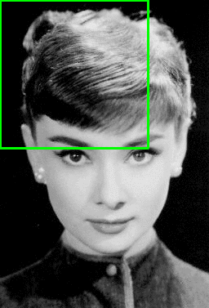
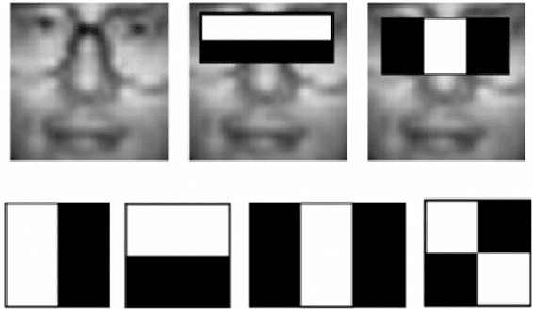
Step 2 – Detection using haar-cascade-classifier
Haar-cascade
An example of a sliding window, moving from left-to-right and top-to-bottom, to locate the face in the image.

Slide 19
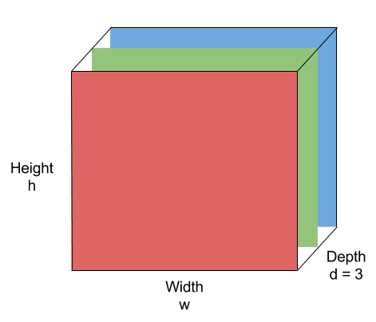
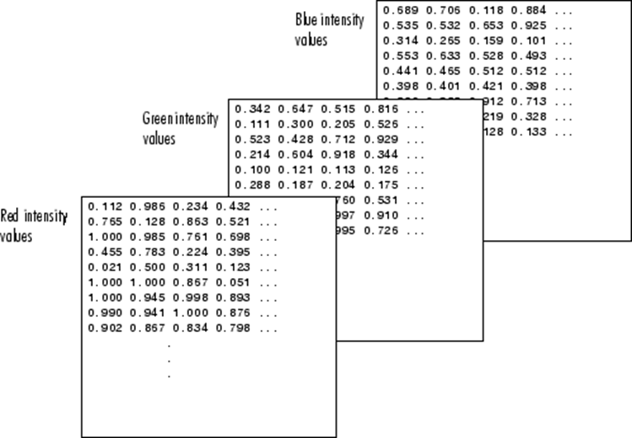

Step 3 – Conversion of Image into Numpy Array
Image
Numpy Array

Slide 20
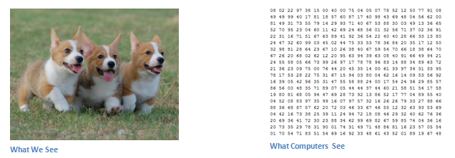
Reason for doing this

Slide 21
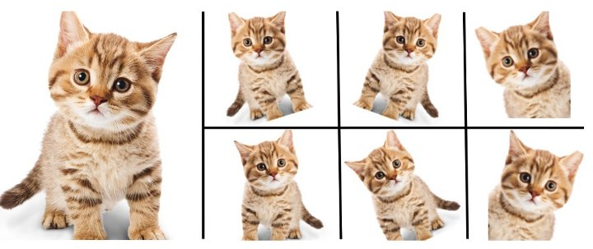
Step 4 – Keras ImageDataGenerator for Image Augmentation
By Applying –
Random Rotations
Random Shifts
Random Flips
Random Brightness
Random Zoom
The ImageDataGenerator class in Keras is used for implementing image augmentation. The major advantage of the Keras ImageDataGenerator class is its ability to produce real-time image augmentation. This simply means it can generate augmented images dynamically during the training of the model making the overall mode more robust and accurate.

Slide 22
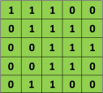


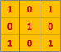

Step 5 – Training the Model
THE CONVOLUTION STEP
Stride = 1
$$=$$
5 x 5 Image
3 x 3 Filter
Stride : Stride is the number of pixels shifts over the input matrix.

Slide 23
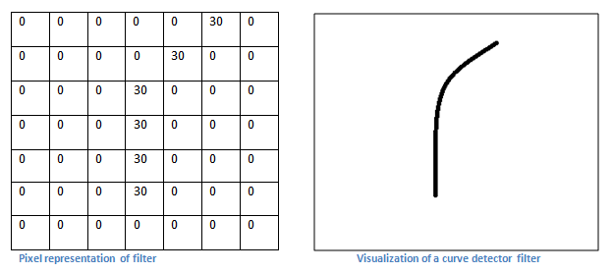
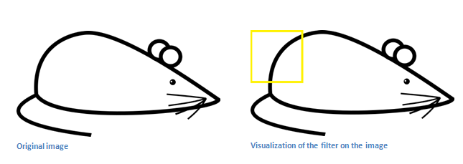
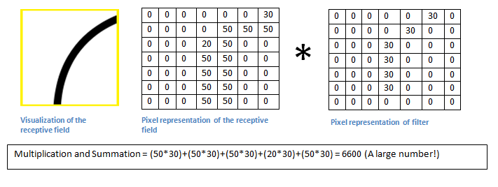
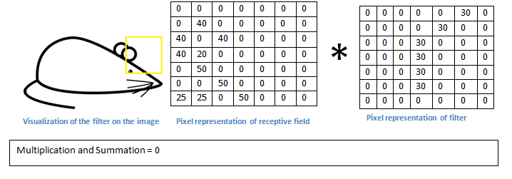
THE CONVOLUTION STEP

Slide 24

THE CONVOLUTION STEP
This layer is the first layer that is used to extract the various features from the input images.
In this layer, the mathematical operation of convolution is performed between the input image and a filter of a particular size MxM.
By sliding the filter over the input image, the dot product is taken between the filter and the parts of the input image with respect to the size of the filter (MxM).
The output is termed as the Feature map which gives us information about the image such as the corners and edges. Later, this feature map is fed to other layers to learn several other features of the input image.
Padding :
Sometimes filter does not fit perfectly fit the input image. We have two options:
Pad the picture with zeros (zero-padding) so that it fits
Drop the part of the image where the filter did not fit. This is called valid padding which keeps only valid part of the image.

Slide 25
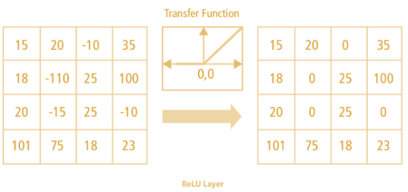


RECTIFIED LINEAR UNIT(RELU) STEP
ReLU stands for Rectified Linear Unit for a non-linear operation.
The output is ƒ(x) = max(0,x).
Image Conversion after Relu Step

Slide 26
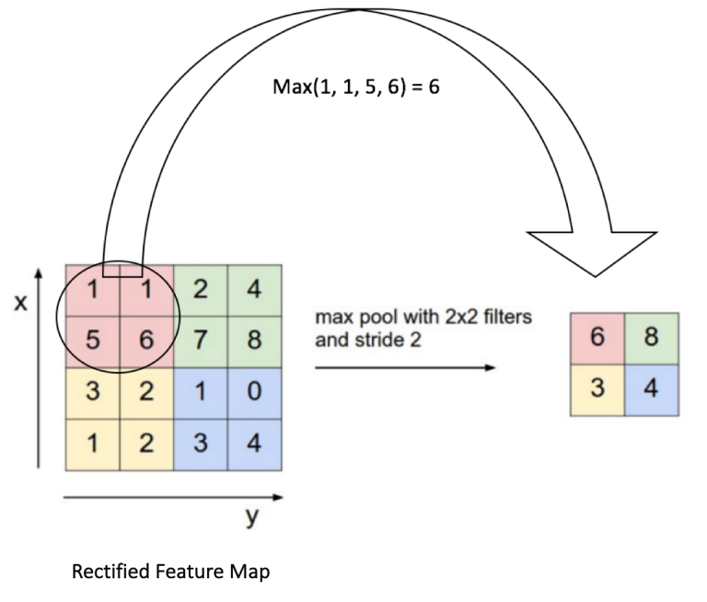
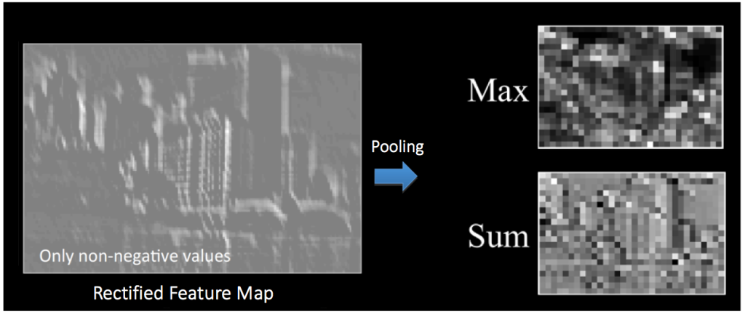
THE POOLING STEP
Spatial Pooling (also called subsampling or downsampling) reduces the dimensionality of each feature map but retains the most important information. Spatial Pooling can be of different types: Max, Average, Sum etc.
In case of Max Pooling, we define a spatial neighborhood (for example, a 2×2 window) and take the largest element from the rectified feature map within that window
Max Pooling

Slide 27

THE FLATTENING STEP
After a series of convolution and pooling operations on the feature representation of the image, we then flatten the output of the final pooling layers into a single long continuous linear array or a vector.
The process of converting all the resultant 2-d arrays into a vector is called Flattening.
Flatten output is fed as input to the fully connected neural network having varying numbers of hidden layers to learn the non-linear complexities present with the feature representation.

Slide 28
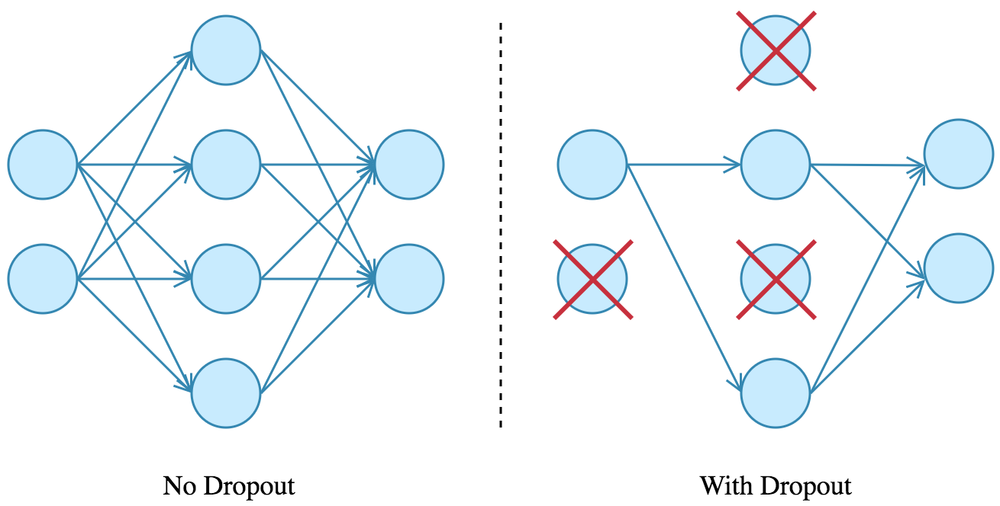
THE DROPOUT STEP
When all the features are connected to the FC layer, it can cause overfitting in the training dataset.
Overfitting occurs when a particular model works so well on the training data causing a negative impact in the model’s performance when used on a new data.
To overcome this problem, a dropout layer is utilized wherein a few neurons are dropped from the neural network during training process resulting in reduced size of the model. On passing a dropout of 0.3, 30% of the nodes are dropped out randomly from the neural network.

Slide 29
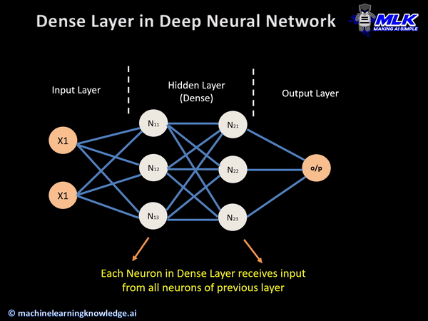
THE DENSE LAYER
The dense layer is a neural network layer that is connected deeply, which means each neuron in the dense layer receives input from all neurons of its previous layer.
In the background, the dense layer performs a matrix-vector multiplication. The values used in the matrix are actually parameters that can be trained and updated with the help of backpropagation.
The output generated by the dense layer is an ‘m’ dimensional vector. Thus, dense layer is basically used for changing the dimensions of the vector. Dense layers also applies operations like rotation, scaling, translation on the vector.

Slide 30
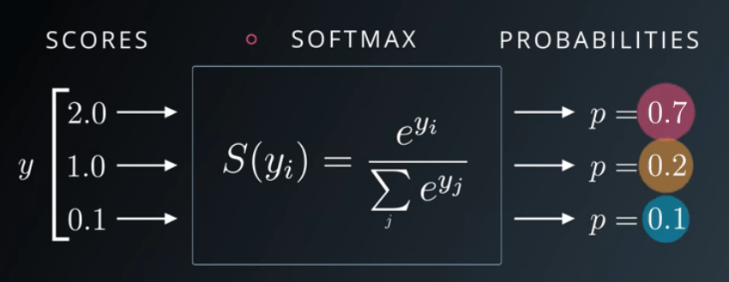
SOFTMAX ACTIVATION FUNCTION
Softmax is often used as the activation for the last layer of a classification network because the result could be interpreted as a probability distribution.
Softmax assigns decimal probabilities to each class in a multi-class problem.
Then we Train the Model for certain Epochs (Iterations)….

Slide 31
applications
Cars - Drowsy driver detection methods can form the basis of a system to potentially reduce the number of crashes related to drowsy driving.
Anti Sleep Pilot - Danish device that can be fitted to any vehicle, uses a combination of accelerometers and reaction tests.
Vigo - Smart Bluetooth headset that detects signs of drowsiness through the eyes and head motion, and uses a combination of light, sound, and vibration to alert the user.

Slide 32
References
https://techvidvan.com/tutorials/driver-drowsiness-detection-system/
https://data-flair.training/blogs/python-project-driver-drowsiness-detection-system/

Slide 33


Slide 34
ALGORITHM
Let’s now understand how our algorithm works step by step :-
Step 1 – Take Image as Input from a Camera
With a webcam, we will take images as input. So to access the webcam, we made an infinite loop that will capture each frame. We use the method provided by OpenCV, cv2.VideoCapture(0) to access the camera and set the capture object (cap). cap.read() will read each frame and we store the image in a frame variable.

Slide 35
ALGORITHM
Step 2 – Detect Face in the Image and Create a Region of Interest (ROI)
To detect the face in the image, we need to first convert the image into grayscale as the OpenCV algorithm for object detection takes gray images in the input. We don’t need color information to detect the objects. We will be using haar cascade classifier to detect faces. This line is used to set our classifier face = cv2.CascadeClassifier(‘ path to our haar cascade xml file’). Then we perform the detection using faces = face.detectMultiScale(gray). It returns an array of detections with x,y coordinates, and height, the width of the boundary box of the object. Now we can iterate over the faces and draw boundary boxes for each face.

Slide 36
ALGORITHM
Step 3 – Detect the eyes from ROI and feed it to the classifier
The same procedure to detect faces is used to detect eyes. First, we set the cascade classifier for eyes in leye and reye respectively then detect the eyes using left_eye = leye.detectMultiScale(gray). Now we need to extract only the eyes data from the full image. This can be achieved by extracting the boundary box of the eye and then we can pull out the eye image from the frame with this code.

Slide 37
ALGORITHM
Step 4 – Classifier will Categorize whether Eyes are Open or Closed
To feed our image into the model, we need to perform certain operations because the model needs the correct dimensions to start with. First, we convert the color image into grayscale using r_eye = cv2.cvtColor(r_eye, cv2.COLOR_BGR2GRAY). Then, we resize the image to 24*24 pixels as our model was trained on 24*24 pixel images cv2.resize(r_eye, (24,24)). We normalize our data for better convergence r_eye = r_eye/255 (All values will be between 0-1). Expand the dimensions to feed into our classifier. We loaded our model using model = load_model(‘models/cnnCat2.h5’) . Now we predict each eye with our model lpred = model.predict_classes(l_eye). If the value of lpred[0] = 1, it states that eyes are open, if value of lpred[0] = 0 then, it states that eyes are closed.

Slide 38
ALGORITHM
Step 5 – Calculate Score to Check whether Person is Drowsy
The score is basically a value we will use to determine how long the person has closed his eyes. So if both eyes are closed, we will keep on increasing score and when eyes are open, we decrease the score. We are drawing the result on the screen using cv2.putText() function which will display real time status of the person.

Slide 39

SOURCE CODE
import cv2
import os
from keras.models import load_model
import numpy as np
from pygame import mixer
import time
mixer.init()
sound = mixer.Sound('alarm.wav')
face = cv2.CascadeClassifier('haar cascade files\haarcascade_frontalface_alt.xml')
leye = cv2.CascadeClassifier('haar cascade files\haarcascade_lefteye_2splits.xml')
reye = cv2.CascadeClassifier('haar cascade files\haarcascade_righteye_2splits.xml')
lbl=['Close','Open']
model = load_model('models/cnncat2.h5’)
……………..

